Slide 1


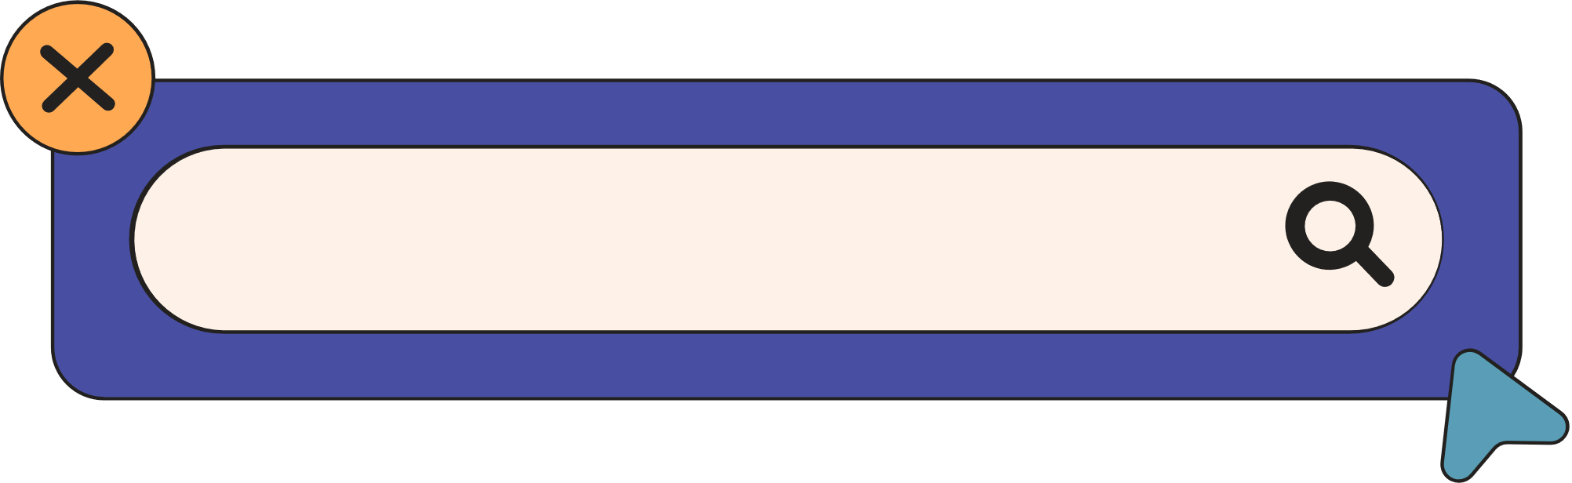

CSCI317 - SOFTWARE ENGINEERING
DATA SHARDING
BY SHAHD AL-SAYEL
DR IBRAHIM . DHAINI

Slide 2
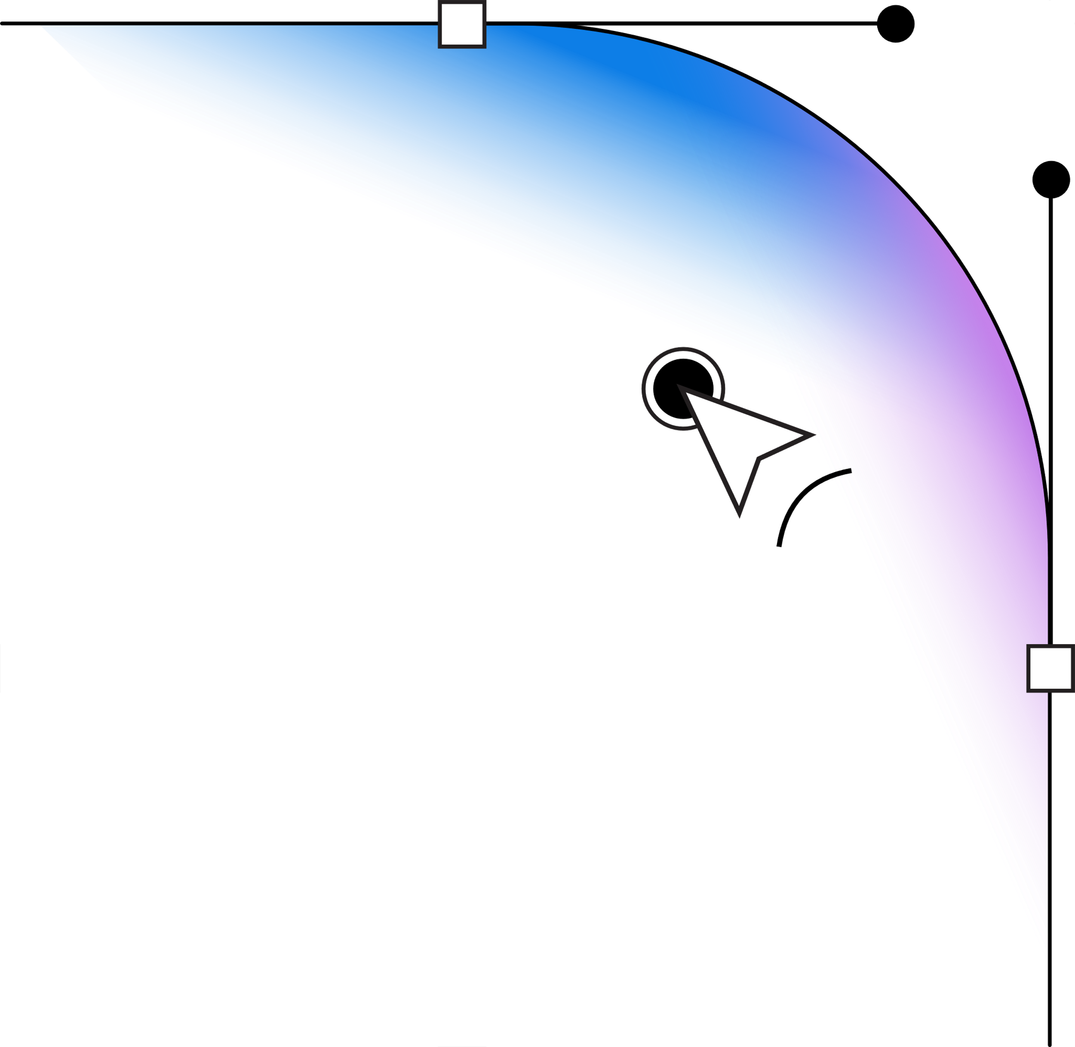

INTRODUCTION
WHAT IS DATA SHARDING ?
Data sharding is the process of breaking a large database into smaller, more manageable pieces called shards. Each shard operates as an independent database, storing a portion of the total dataset. This improves performance, scalability, and fault tolerance, making it a common strategy for handling massive amounts of data in distributed systems

Slide 3


HOW IT WORKS ?
SHARDING KEY :
A sharding key is a critical piece of data used to determine how data is distributed across different shards. Choosing the right sharding key is essential because it affects performance, scalability, and query efficiency
Range-based sharding: Split by ranges (e.g., IDs 1–200 in Shard A, 201–400 in Shard B).
Hash-based sharding: Use a hash function to evenly spread data.
Geographic sharding: Assign data by location (e.g., U.S. users in one shard, Europe in another).

Slide 4


PROCESS (BASIC STEPS)
HOW IT WORKS ?
Choosing a Sharding Key – Determines how data is divided (e.g., User ID, Region).
Distributing Data – Data is split into multiple shards based on the key.
Querying Data – The system uses the key to find the correct shard quickly.
Scaling Efficiently – New shards can be added as data grows

Slide 5

PROS AND CONS
BENEFITS OF DATA SHARDING :
✅ Better Performance – Queries run faster by accessing specific shards instead of a single large database.
✅ Scalability – New shards can be added easily as data volume increases.
✅ Fault Isolation – A failure in one shard doesn’t affect others, keeping the system operational.
✅ Efficient Load Balancing – Distributes queries evenly, preventing bottlenecks

Slide 6


PROS AND CONS
FAILURES IN DATA SHARDING :
⚠️ Single Shard Overload (Hotspot Problem) – Some shards may get too much traffic, causing slowdowns or failures.
⚠️ Shard Failure (Data Loss Risk) – If a shard fails, the data within it becomes inaccessible unless replicated.
⚠️ Cross-Shard Transactions Complexity – Queries that need data from multiple shards can slow down performance and increase complexity.

Slide 7


EXAMPLES
REAL-WORLD APPLICATIONS OF DATA SHARDING :
E-Commerce – Helps manage large customer and product data, improving speed and handling high traffic (e.g., Amazon).
Social Media – Distributes user data across servers, ensuring fast access and scalability (e.g., Facebook).
Financial Services – Speeds up transactions and increases reliability by distributing data (e.g., online banking).
Gaming – Ensures fast load times and smooth play by spreading player data (e.g., Fortnite).

Slide 8


SOFTWARE ENGINEERING ?
DATA SHARDING IN SOFTWARE ENGINEERING :
Scalable Systems – Sharding helps build applications that handle large data and users efficiently.
Performance & Load Balancing – Distributes data across servers, preventing slowdowns and maintaining smooth performance.
Fault Tolerance – Sharding isolates failures to specific shards, keeping the system running.
Architectural Choices – Engineers select sharding strategies (hashing, range, etc.) based on system needs.

Slide 9
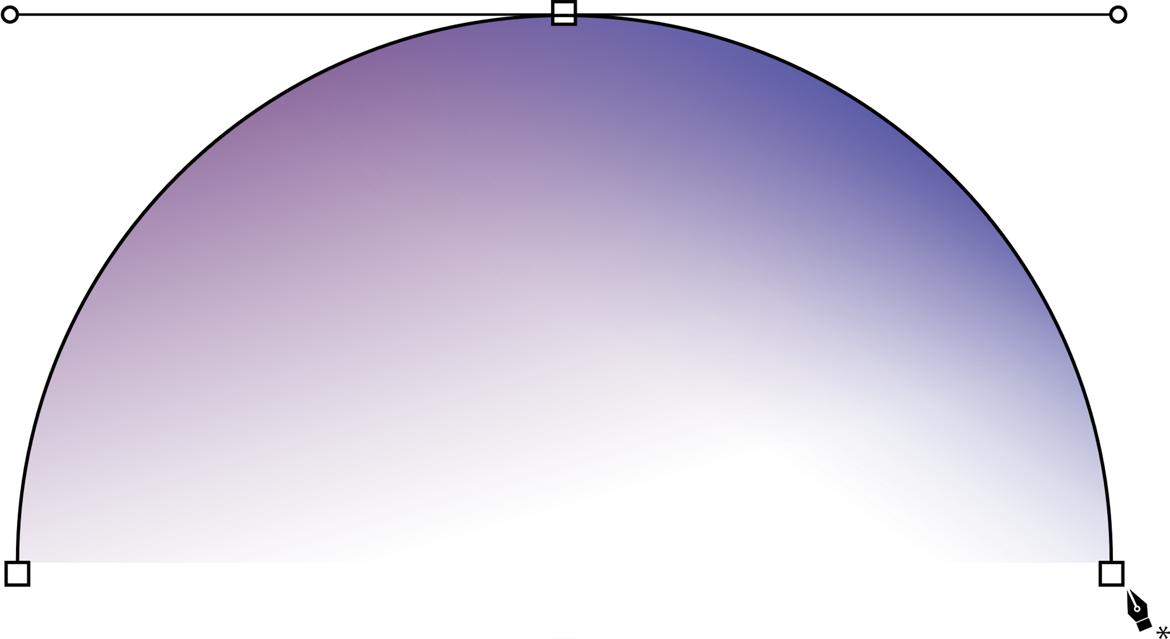
THANK YOU!

